Slide 1
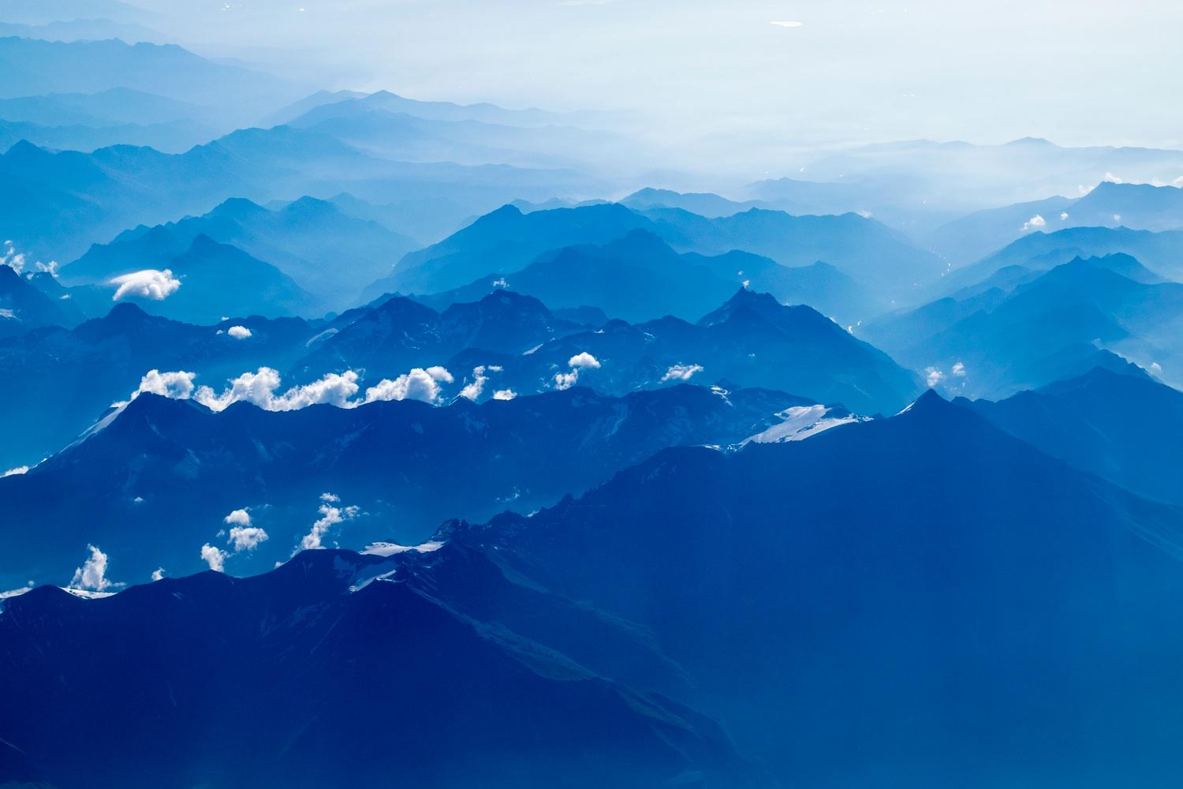
Procedural city generation using Perlin noise

Slide 2

Welcome!
Presented by:
Niclas Olsson
Elias Frank
Notes:
Present ourselves

Slide 3
Introduction
1
Motivation and summary
Notes:
This will be in the introduction:
Motivation of work
Motivation of Perlin noise
Video
Summarize the work

Slide 4
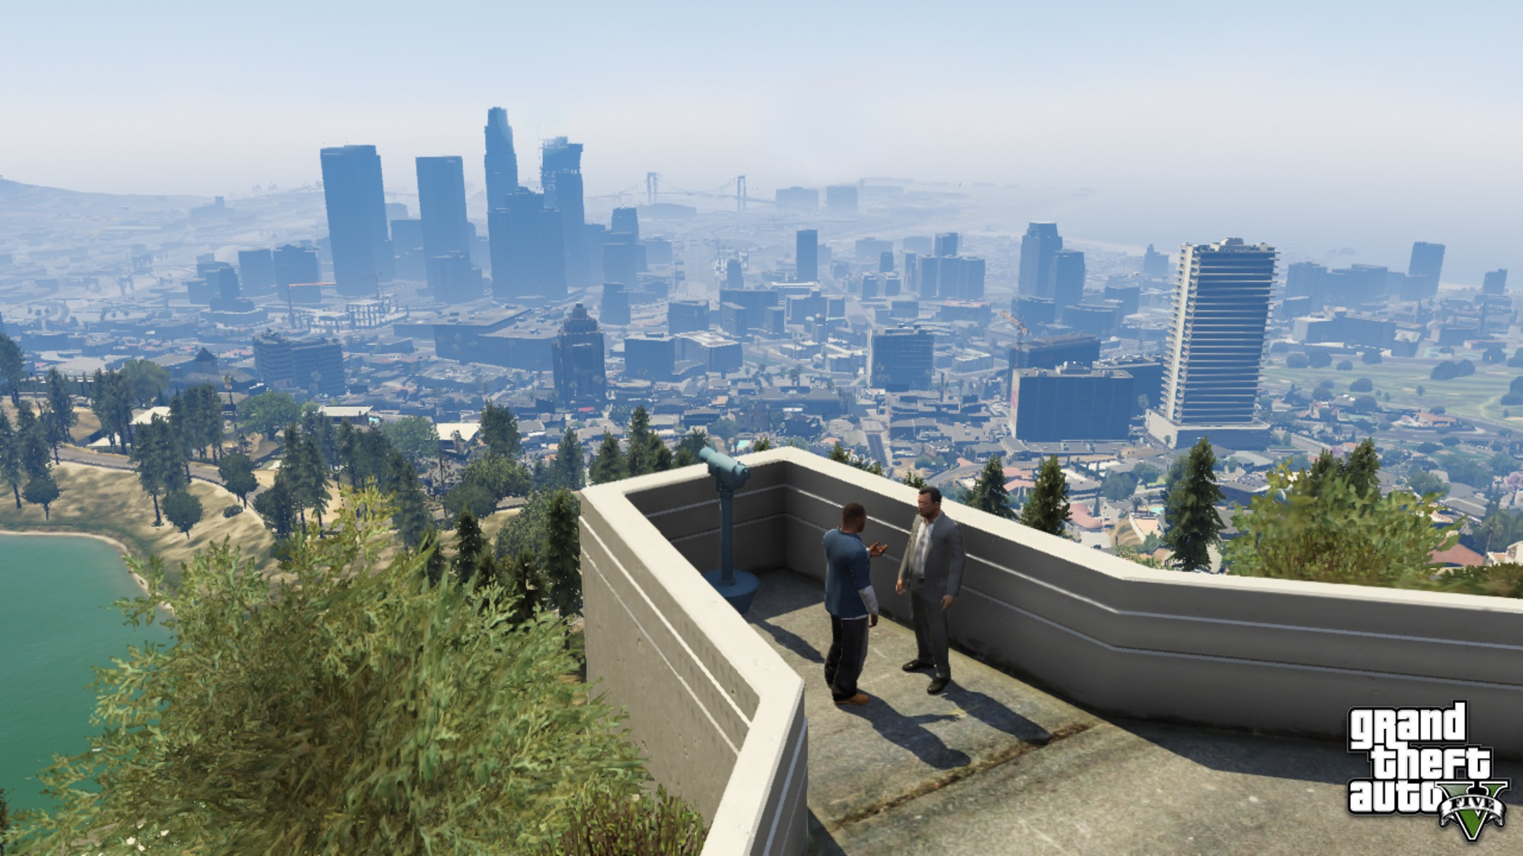
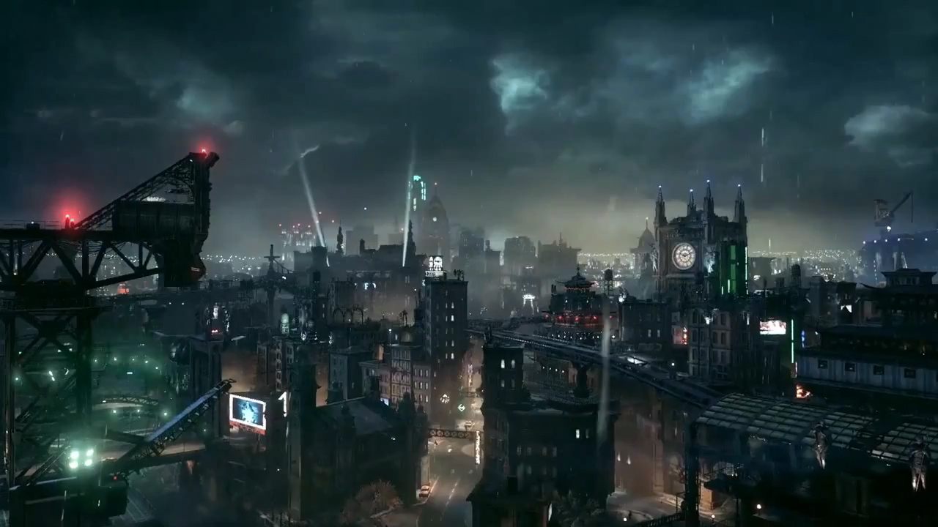
Successful games
GTA V
Batman Arkham city

Slide 5
Method
2
Implementation and evaluation
Notes:
This will be in the method:
Briefly explain Perlin noise
Explain PCG pipeline
-Districts
-Blocks
-Buildings
Explain user study:
-Questionnaire
-Images
-Motivate

Slide 6

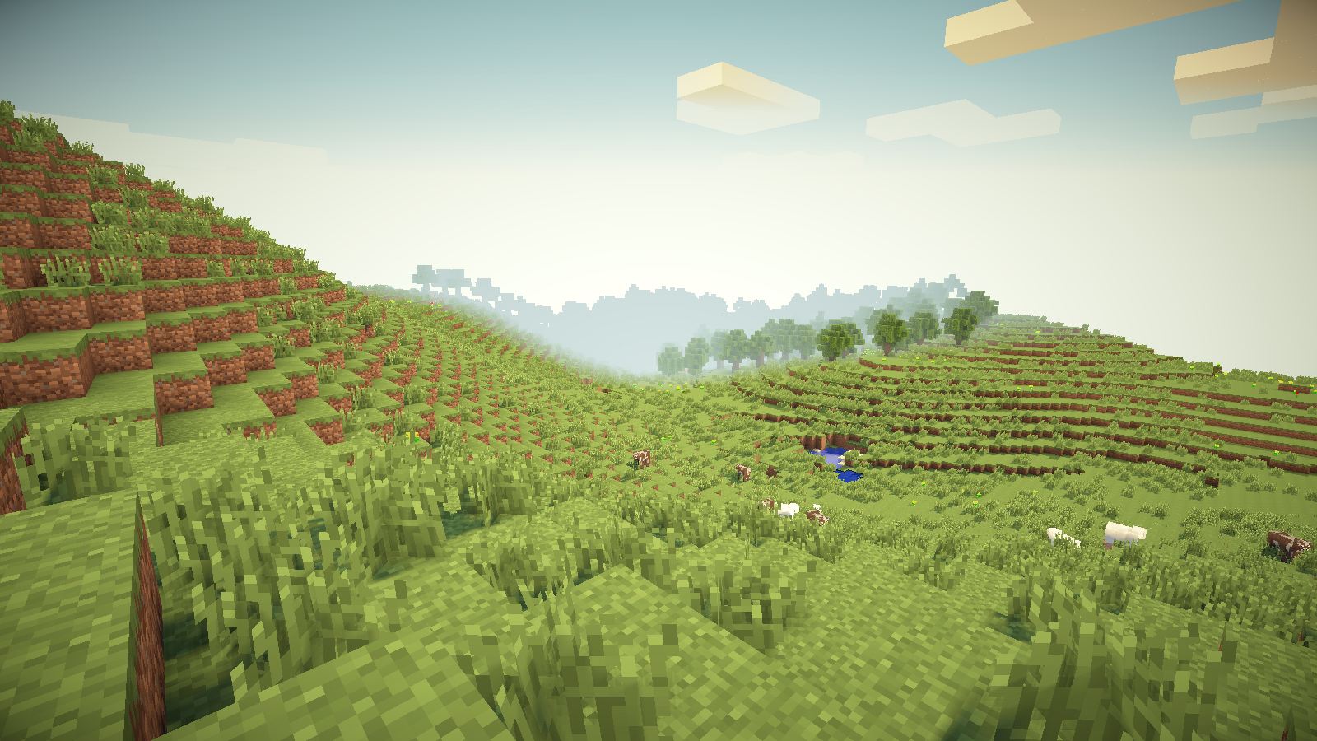
Perlin noise
Developed by Ken Perlin in 1984
Improved in 2001
Common in PCG
Notes:
Ken Perlin used it for textures in movies, won award.
Top image is of typical Perlin noise.
Bottom image is Minecraft, using Perlin noise for the terrain.

Slide 7
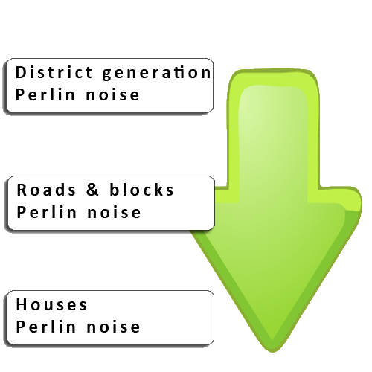
PCG pipeline
Top-down
-Districts
-Blocks
-Buildings
Notes:
Pipeline is top-down: every step depends on the previous
Every step uses Perlin noise
Intermediate format is a 2D-array

Slide 8
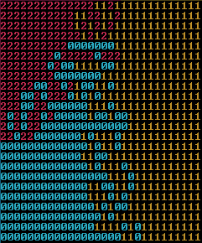
Districts
Nicras not knowings
Depends on:
Seed

Slide 9
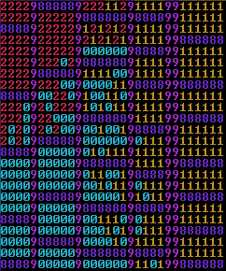
Blocks
Main roads first
Small roads second
Depends on:
Block size
Notes:
Generate main roads first. Main roads run all the way through the city. Walk the grid horizontally. (pink 9s)
Fill the gaps between main roads with smaller roads. Walk the gaps vertically. (purple 8s)
Creates blocks.

Slide 10
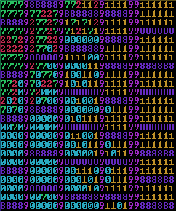
Buildings
Determine building or vacant
Generate building
Depends on:
Min/Max height
Building sections
Notes:
Uses Perlin to determine if we should place a building or leave it vacant (green 7)
When generating a building, take into consideration the building sections of the district
Also take into consideration the min and max height of the district

Slide 11
User Study
Evaluation of the implementation.
Notes:
We evaluated the viability of the implementation through a user study.
The reasoning behind the user study was to show participants images of generated cities and let them determine if they think the cities are viable to be used in games.

Slide 12
Questionnaire
1. How often do you play games?
2. Which city looks most random?
3. Which city looks most natural?
4. Which city looks least natural?
5. Which city (if any) could be used in a game?
6. Which city looks the most repetitive?
7. Which city looks the prettiest?
8. Which city looks the ugliest?
9. Which city has the best road network?
Notes:
This was the questionnaire used in the user study. We will show the results a little later on.
The idea behind the first question was to determine if familiarity with games would bias the answers to the questions.
Unfortunately, a majority of the participants was from the same group, which shows some selection bias.
From these questions we wanted to determine the impact that our pipeline had on the result.
The most notable question is number 5, which directly correlates to our research question.

Slide 13
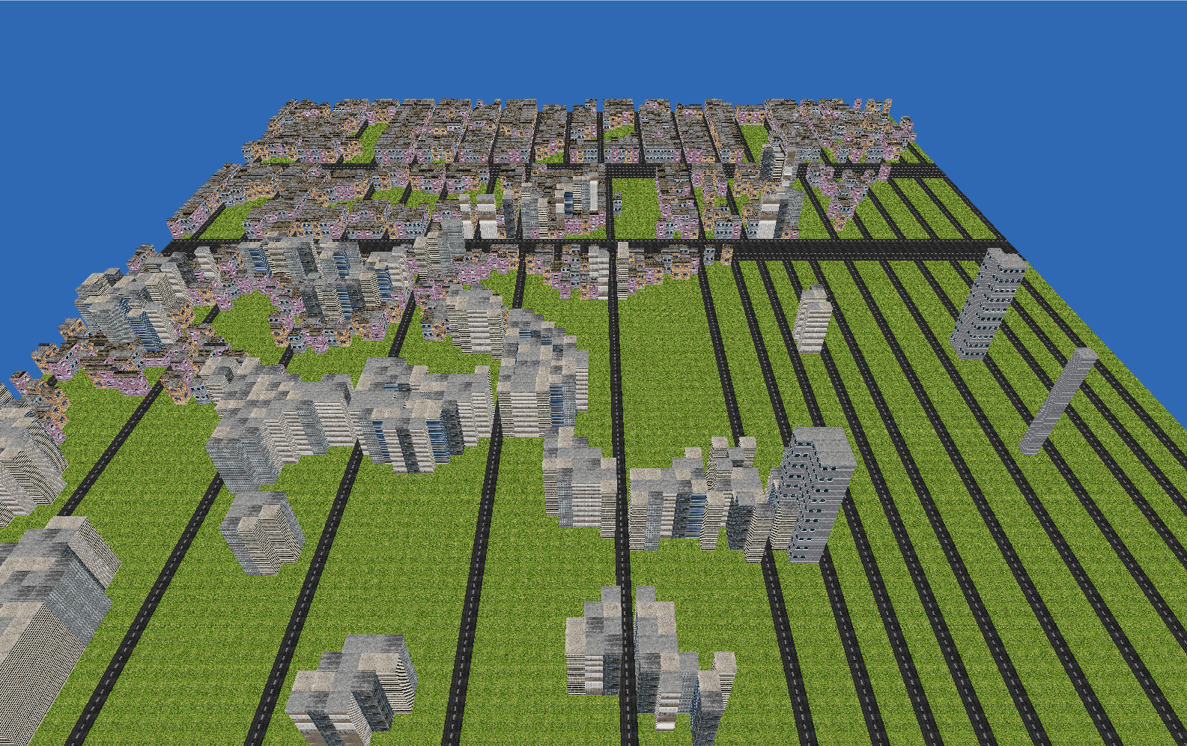
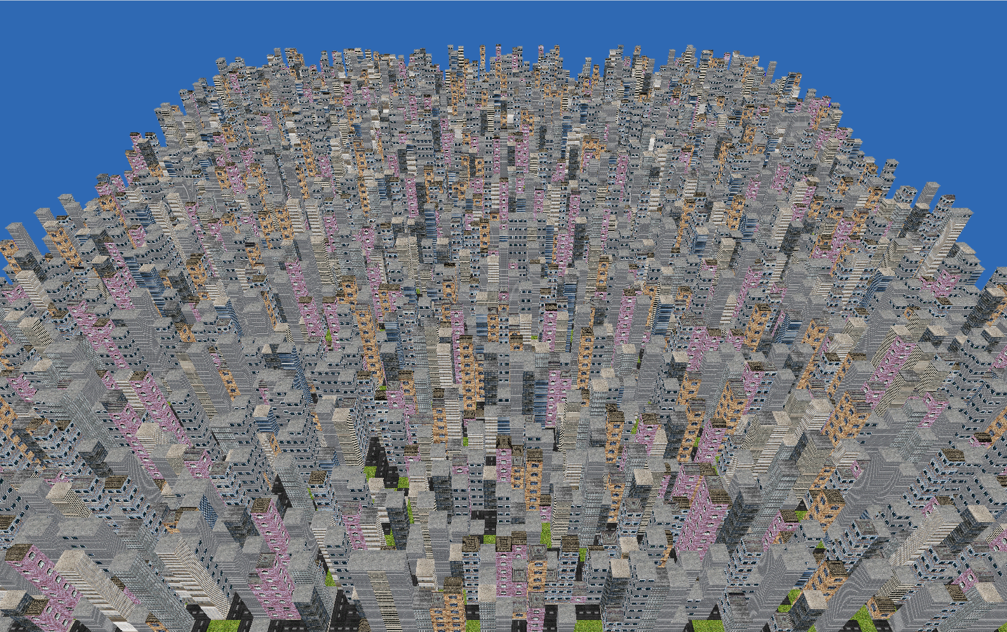
Notes:
Top-left: Bad parameters
Bottom-right: Full random (using rand)

Slide 14
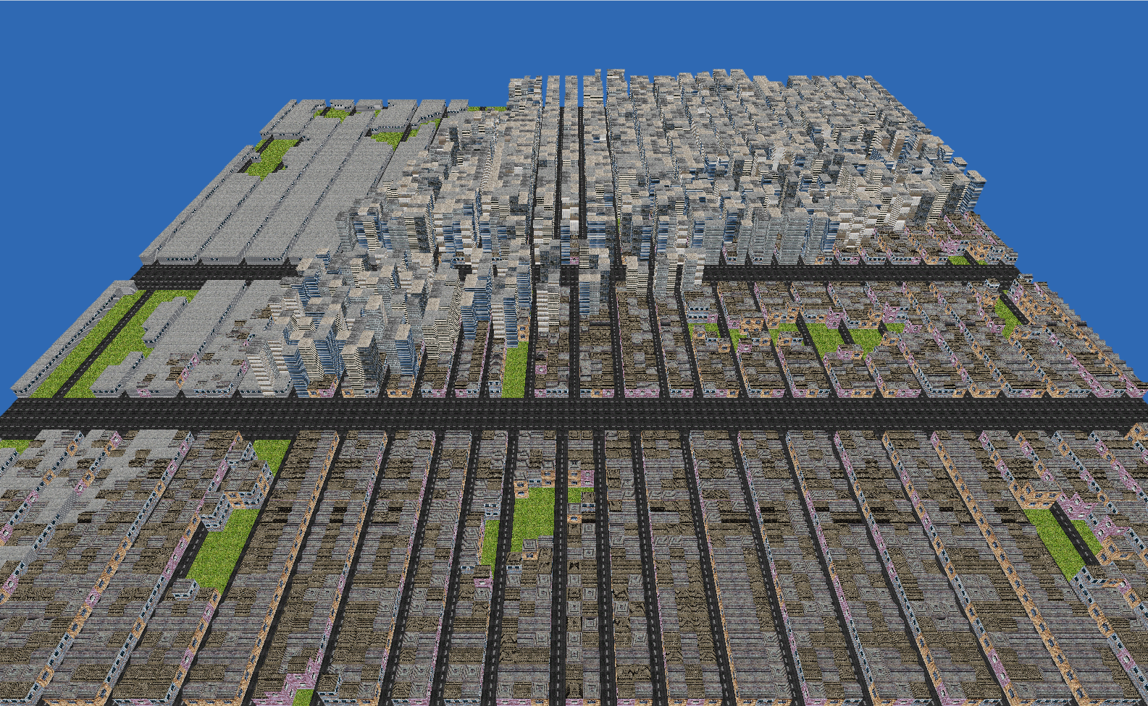
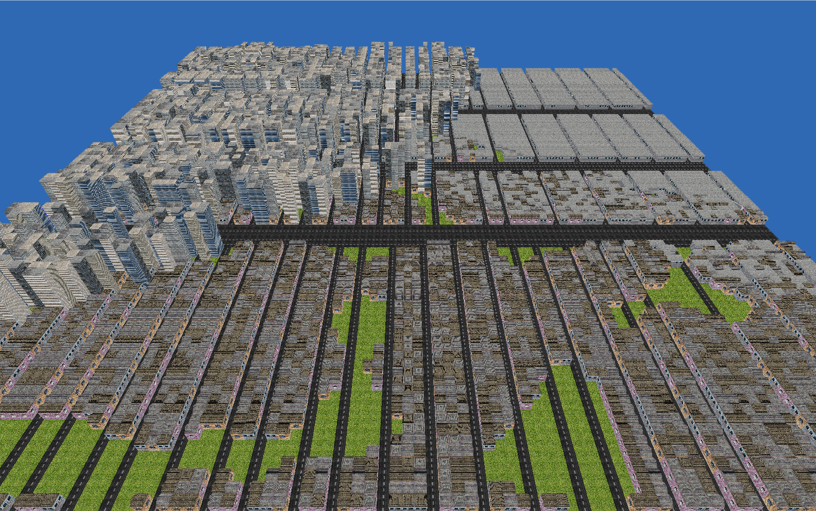
Notes:
Two cities with good parameters

Slide 15
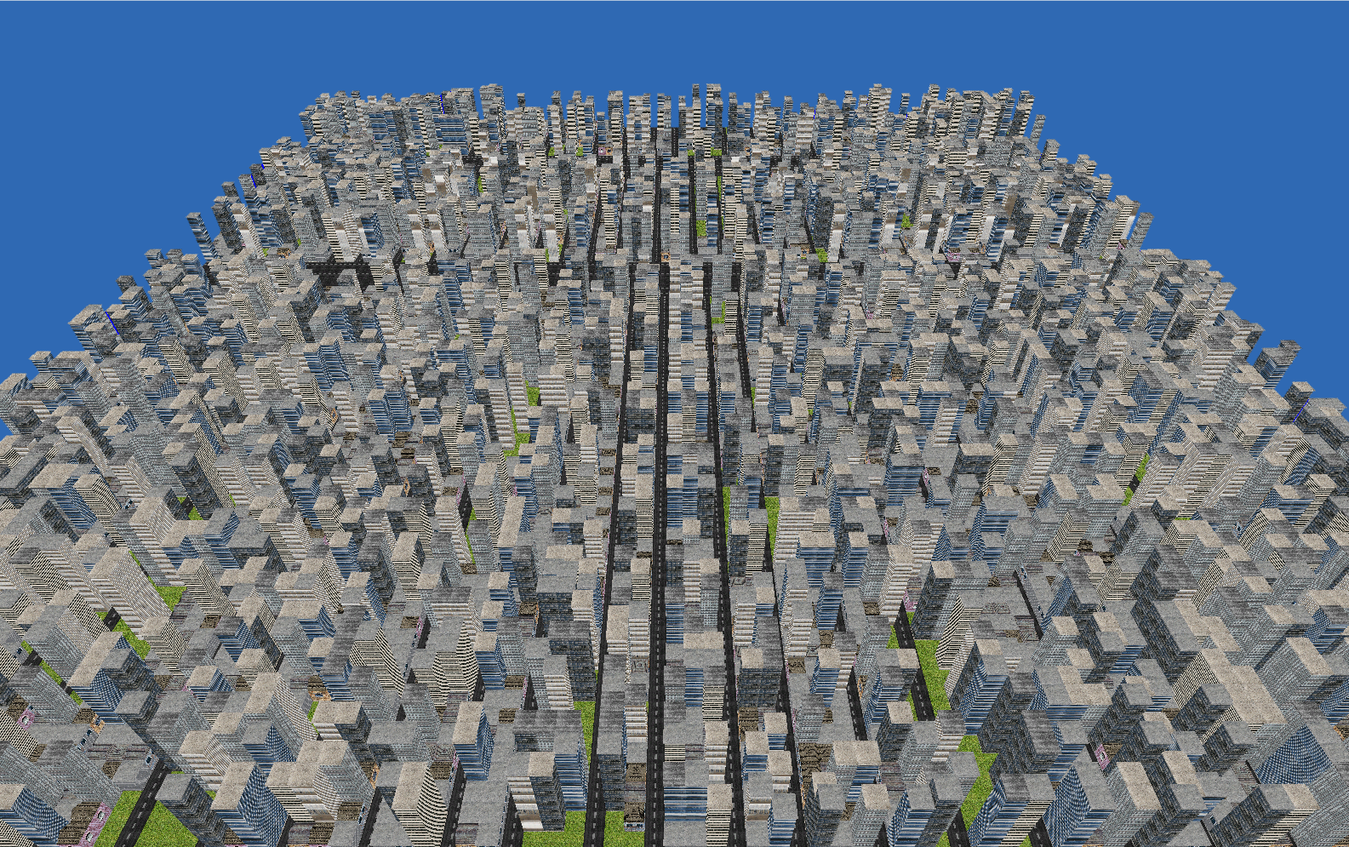
Notes:
Random districts (using rand)
Note: They were not shown in this order during the user study.
The images were printed out on seperate A4-papers and labeled with numbers.

Slide 16
Maps
our office

Slide 17
89,526,124
Whoa! That’s a big number, aren’t you proud?

Slide 18
89,526,124$
185,244 users
100%
That’s a lot of money
And a lot of users
Total success!

Slide 19
Our process is easy
first
last
second

Slide 20
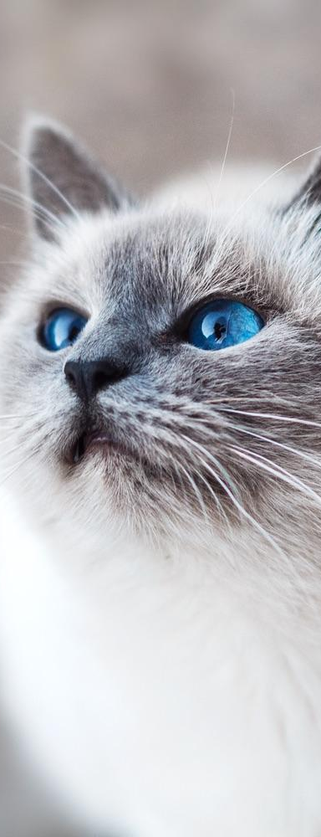
Let’s review some concepts
Yellow
Is the color of gold, butter and ripe lemons. In the spectrum of visible light, yellow is found between green and orange.
Blue
Is the colour of the clear sky and the deep sea. It is located between violet and green on the optical spectrum.
Red
Is the color of blood, and because of this it has historically been associated with sacrifice, danger and courage.
Yellow
Is the color of gold, butter and ripe lemons. In the spectrum of visible light, yellow is found between green and orange.
Blue
Is the colour of the clear sky and the deep sea. It is located between violet and green on the optical spectrum.
Red
Is the color of blood, and because of this it has historically been associated with sacrifice, danger and courage.

Slide 21
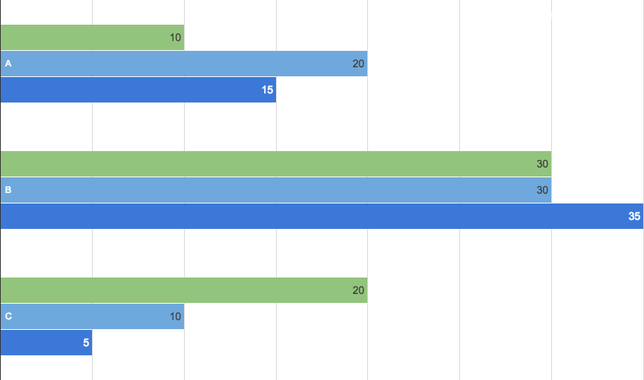
You can insert graphs from Google Sheets

Slide 22
Android project
Show and explain your web, app or software projects using these gadget templates.
Place your screenshot here

Slide 23
iPhone project
Show and explain your web, app or software projects using these gadget templates.
Place your screenshot here

Slide 24
Tablet project
Show and explain your web, app or software projects using these gadget templates.
Place your screenshot here

Slide 25
Desktop project
Show and explain your web, app or software projects using these gadget templates.
Place your screenshot here

Slide 26

Thanks!
Any questions?
You can find me at
@username
user@mail.me

Slide 27
Credits
Special thanks to all the people who made and released these awesome resources for free:
Presentation template by SlidesCarnival
Photographs by Unsplash

Slide 28
Presentation design
You don’t need to keep this slide in your presentation. It’s only here to serve you as a design guide if you need to create new slides or download the fonts to edit the presentation in PowerPoint®
This presentation uses the following typographies and colors:
Titles: Droid serif
Body copy: Pontano Sans
You can download the fonts on these pages:
https://www.fontsquirrel.com/fonts/droid-serif
http://www.1001fonts.com/pontano-sans-font.html
Cyan #33ccff
Navy #162d5a
Turquoise #33cccc
Fluor green #a7ea52

Slide 29
SlidesCarnival icons are editable shapes.
This means that you can:
Resize them without losing quality.
Change fill color and opacity.
Change line color, width and style.
Isn’t that nice? :)
Examples:

Slide 30
😉
Now you can use any emoji as an icon!
And of course it resizes without losing quality and you can change the color.
How? Follow Google instructions https://twitter.com/googledocs/status/730087240156643328
✋👆👉👍👤👦👧👨👩👪💃🏃💑❤😂😉😋😒😭👶😸🐟🍒🍔💣📌📖🔨🎃🎈🎨🏈🏰🌏🔌🔑 and many more...

Slide 31
References
GTA V image: https://disegnodaily.imgix.net/system/dragonfly/production/2013/10/02/12_32_29_314_481_1280.jpg?w=2000
Batman image: http://vignette1.wikia.nocookie.net/batman/images/3/32/BatmanArkhamKnightGothamCity.jpg/revision/latest?cb=20140530010522

